Slide 1




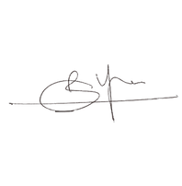



CERTIFICATE
OF WINNER
is proudly presented to
Participant Name
FOR WINNING IN LUDO ORGANISED BY
LEVEL UP SOCIETY ON NOVEMBER 17th,2023
CONVENOR

